Slide 1
Lending Club Case Study
MR. Omkar Amale
As part of IIT-B AI & ML course submission

Slide 2
Objective
The goal of this case study is to apply Exploratory Data Analysis (EDA) to a real-world scenario, extracting valuable insights and presenting them from a business perspective through a comprehensive presentation.
Key Benefits:
Offers practical experience in using EDA to tackle real-world business challenges.
Provides foundational knowledge of risk analysis within banking and financial services.
Demonstrates how data can be leveraged to reduce financial risk in client lending.
Enhances skills in data visualization, including selecting appropriate charts for practical data applications.

Slide 3
Business Understanding
The business objective is to decide whether to approve or reject each loan application based on specific factors.
The dataset includes information on previous loan applicants and indicates whether they “defaulted” or not. It contains data on approved loans only, with three loan statuses: Fully Paid, Current, and Charged-Off.
Importing the Data
Removing large null value columns
Removing irrelevant columns
Removing/Fixing null values
Correcting data types and deriving new columns
Filter Data for requirement.
Removing Duplicate Data
Removing outliers

Slide 4
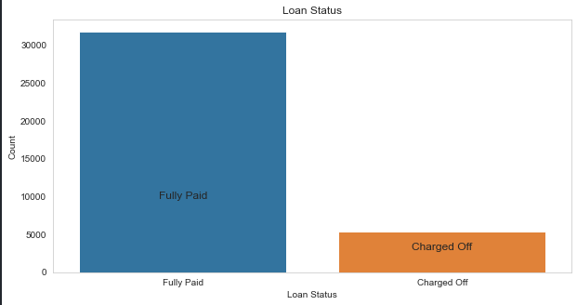
Loan Status – overall
Loan Status: The number of charged off loan is 14.5%.

Slide 5
Uni-variate analysis observations as below
Key Insights on "Charged-Off" Loans with Higher Default Risk
Applicant Type: Renters have a higher likelihood of defaulting.
Loan Purpose: Loans taken for debt consolidation show a greater risk of default.
Verification Status: Applications marked as "Not Verified" are more likely to default.
Loan Term: Terms exceeding 36 months are associated with higher default rates.
Funding Range: Funded amounts between $5,000 and $10,000 are at higher risk.
Loan Amount: Loans within the $5,000 to $10,000 range have higher chances of default.
Installment Range: Monthly installments between $145 and $274 show increased default risk.
Debt-to-Income (DTI) Ratio: Ratios between 12% and 18% are linked to higher defaults.
Additional Observations
Seasonal Trends: December shows a spike in defaults for disbursed loans.
Economic Impact: Financial crises, such as in 2011, correlate with increased charged-off loans.

Slide 6
BI-variate analysis observations as below
Based on Bi-Variate Analysis of "Charged-Off" Loans, the Following Applicant Categories Show the Highest Default Risk:
Applicants taking loans for home improvement with an income between $60k - $70k
Applicants with MORTGAGE home ownership and an income between $60k - $70k
Applicants with loan amounts in the range of $30k - $35k who are charged an interest rate of 15% - 17.5%

Slide 7
Univariate Analysis

Slide 8
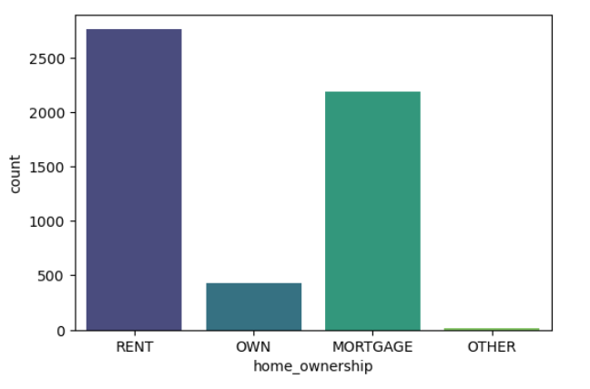
Applicant Type: Renters have a higher likelihood of defaulting.

Slide 9
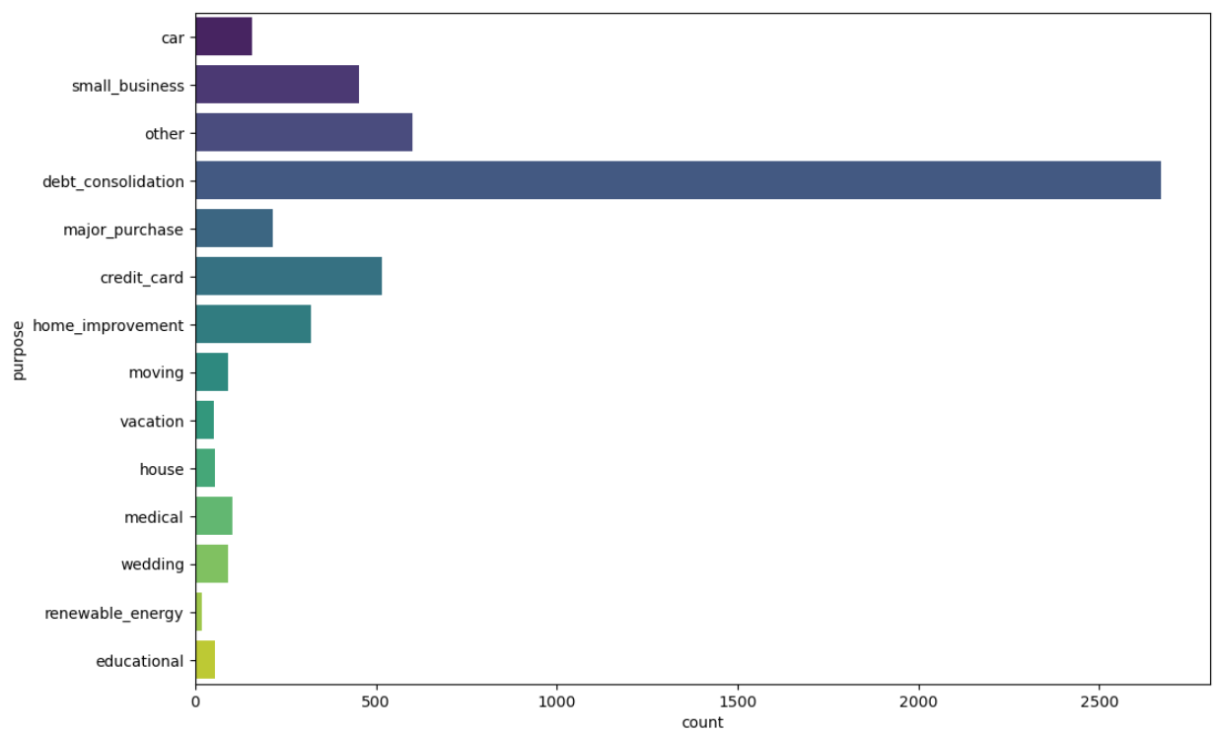
Loan Purpose: Loans taken for debt consolidation show a greater risk of default.

Slide 10
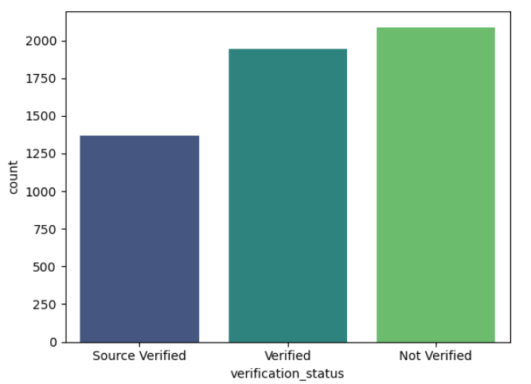
Verification Status: Applications marked as "Not Verified" are more likely to default.

Slide 11
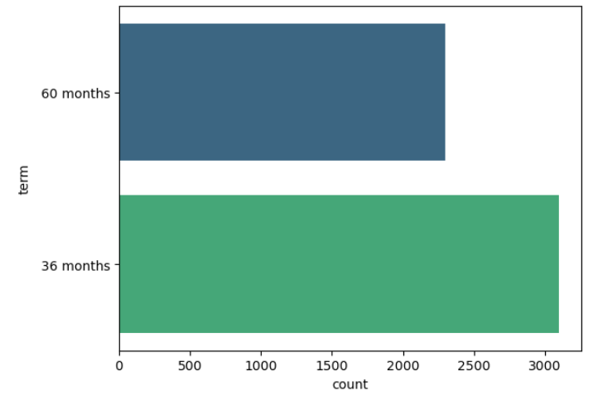
Loan Term: Terms exceeding 36 months are associated with higher default rates.

Slide 12
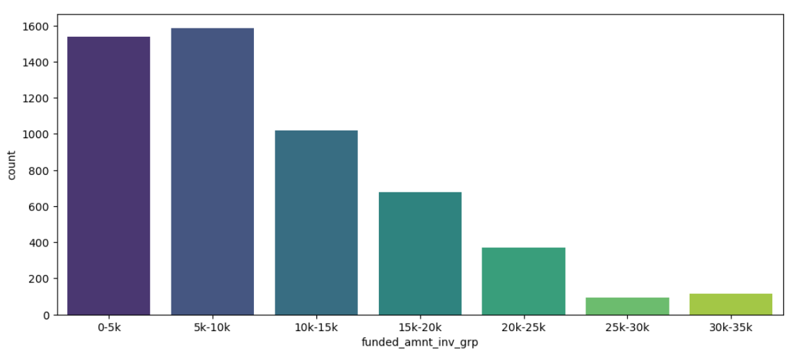
Funding Range: Funded amounts between $5,000 and $10,000 are at higher risk.

Slide 13
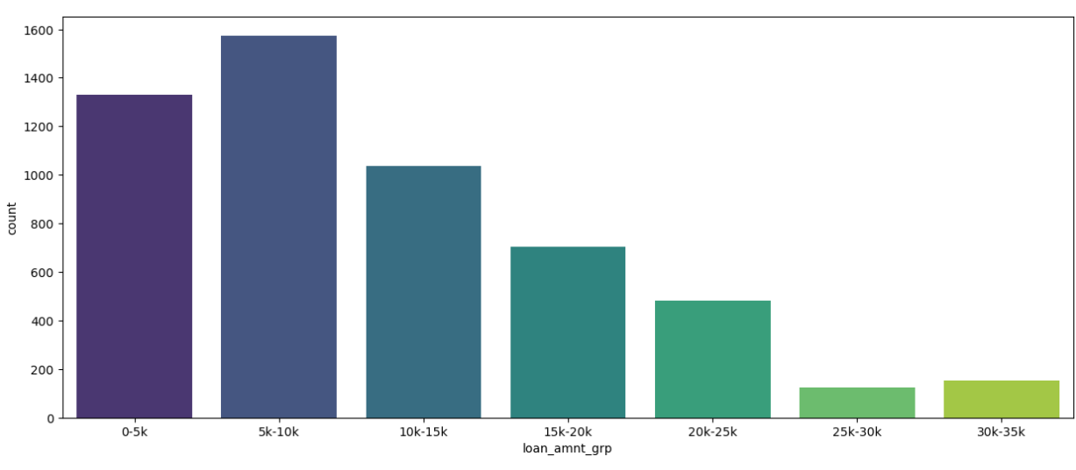
Loan Amount: Loans within the $5,000 to $10,000 range have higher chances of default.

Slide 14
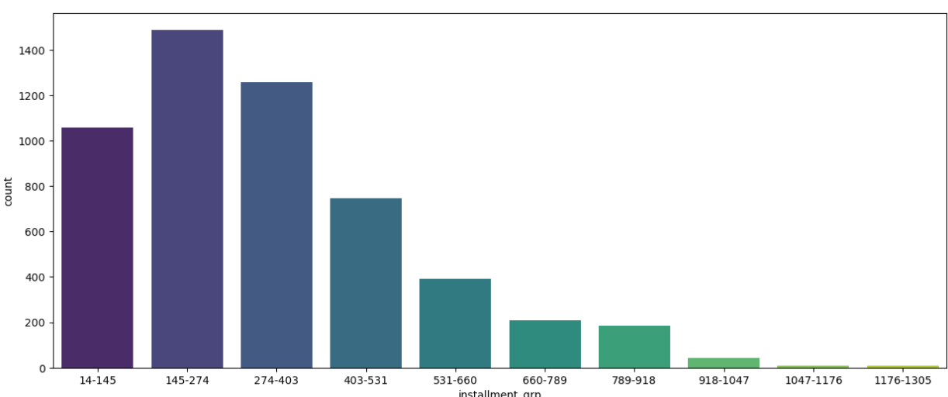
Installment Range: Monthly installments between $145 and $274 show increased default risk.

Slide 15
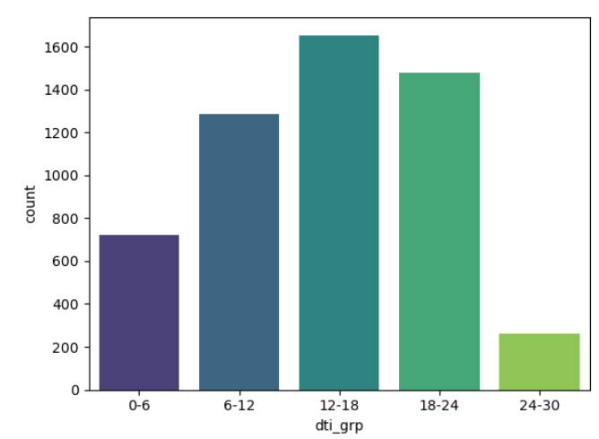
Debt-to-Income (DTI) Ratio: Ratios between 12% and 18% are linked to higher defaults.

Slide 16
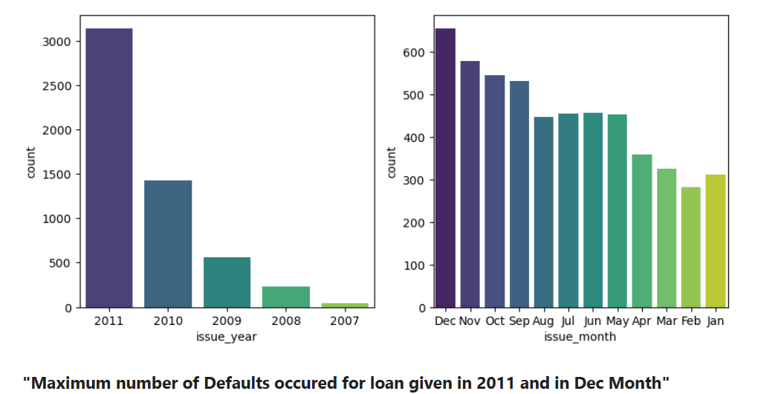
Additional Observations Seasonal Trends: December shows a spike in defaults for disbursed loans. Economic Impact: Financial crises, such as in 2011, correlate with increased charged-off loans.

Slide 17
Bi-Variate analysis

Slide 18
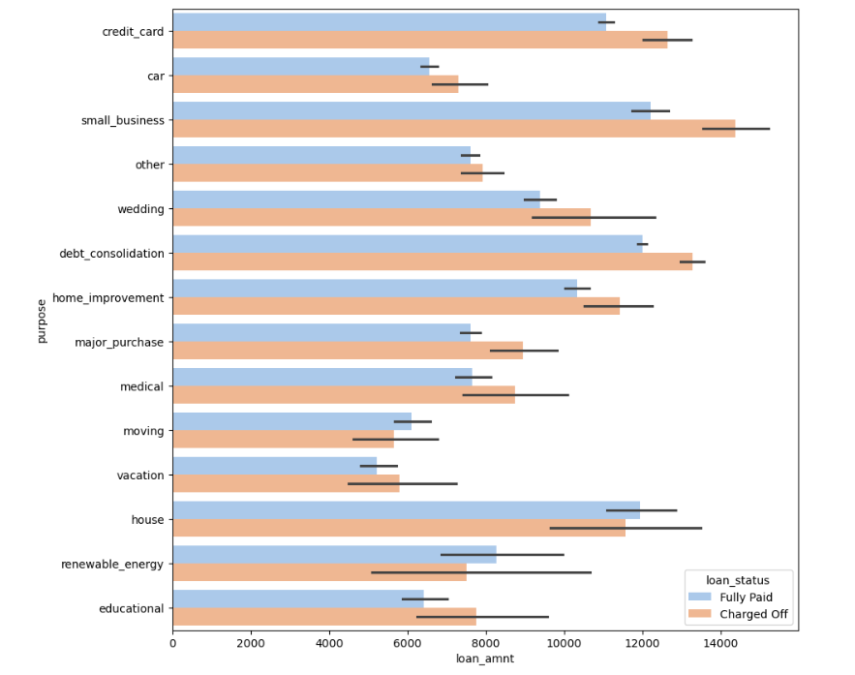
Applicants taking loans for home improvement with an income between $60k - $70k

Slide 19
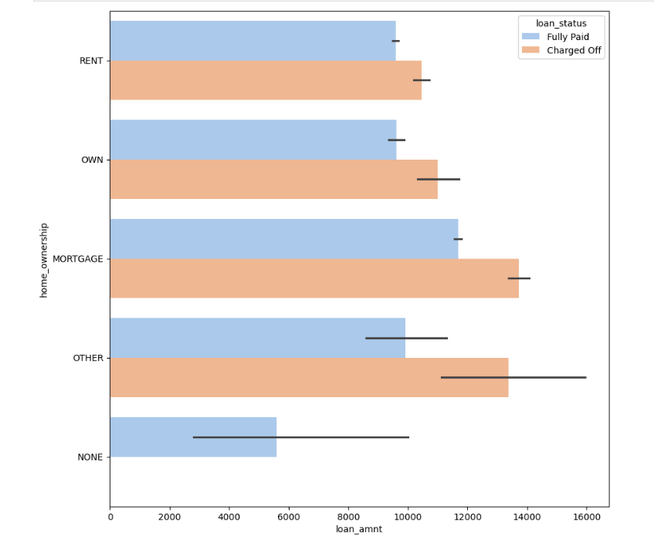
Applicants with MORTGAGE home ownership and an income between $60k - $70k

Slide 20
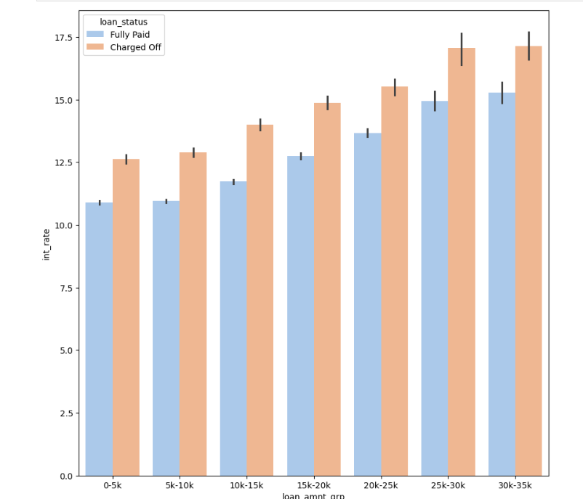
Applicants with loan amounts in the range of $30k - $35k who are charged an interest rate of 15% - 17.5%

